Slide 1
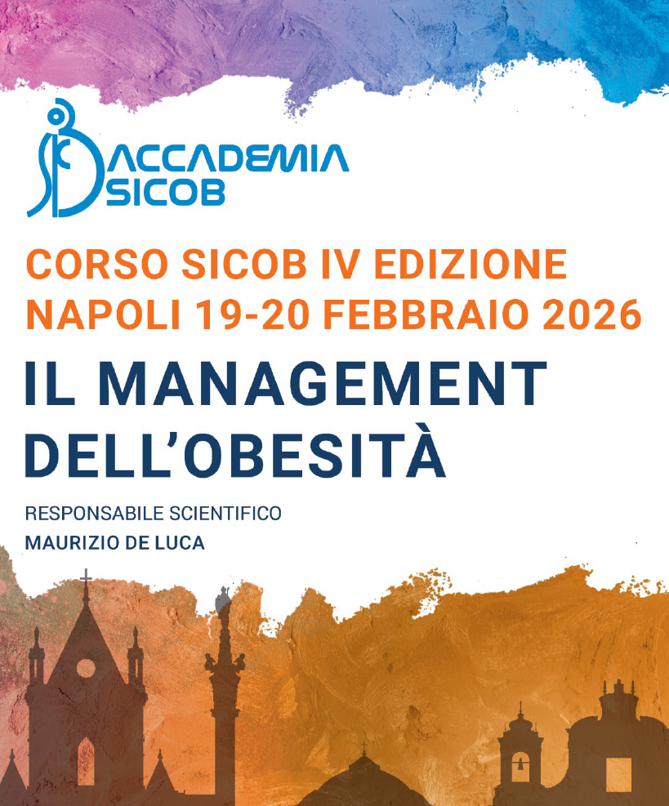
Lifestyle interventions: definizione e ruolo nel trattamento multimodale dell’obesità
Dr. Francesca Battista MD, PhD
Sport and Exercise Medicine Division
University of Padova, Italy
francesca.battista@unipd.it

Slide 2
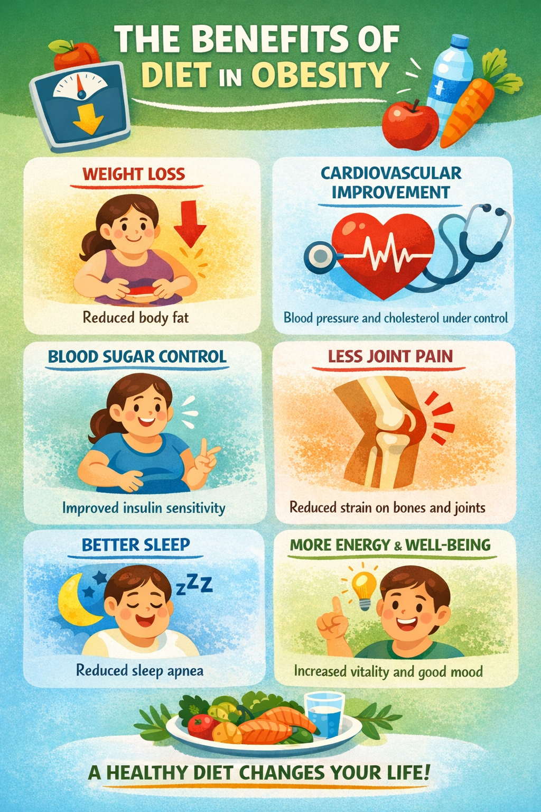
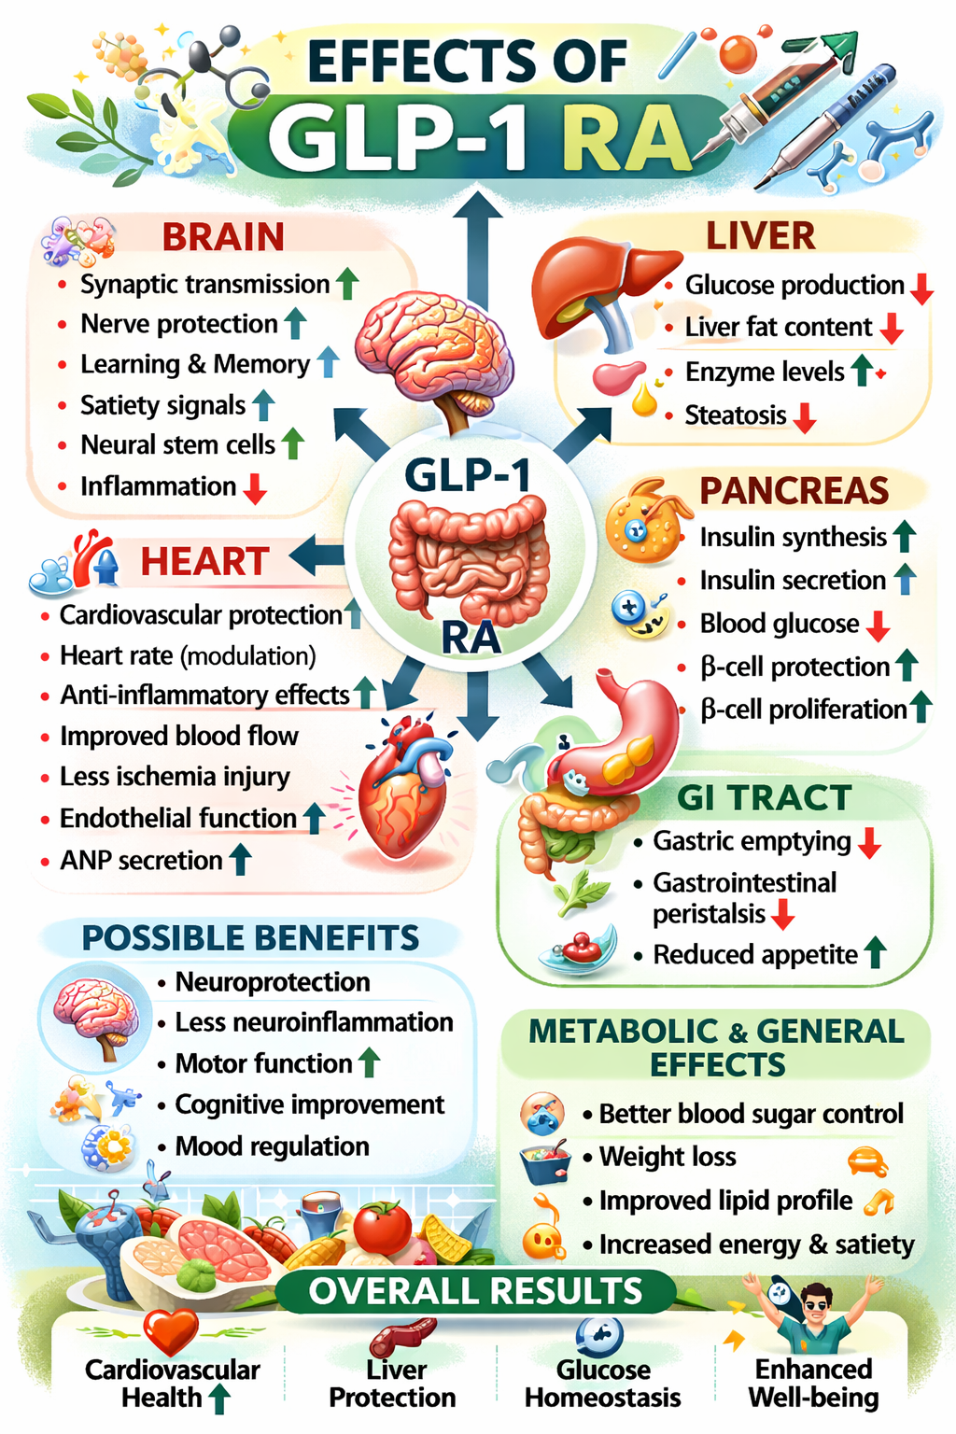
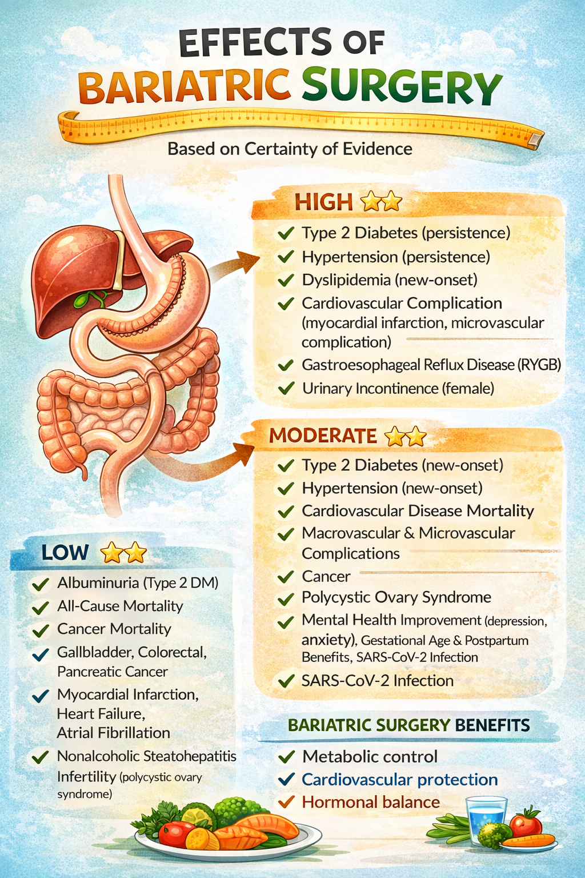
Adapted from Zhao X, et al. Front. Endocrinol. 12:721135.
Adapted from Kim, et al. Ob Rev . 2022.

Slide 3
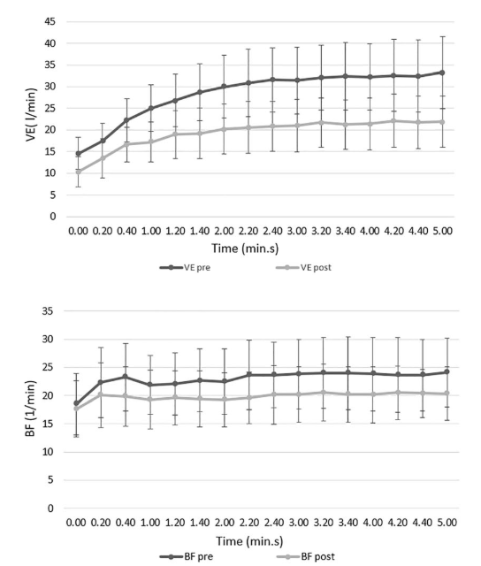
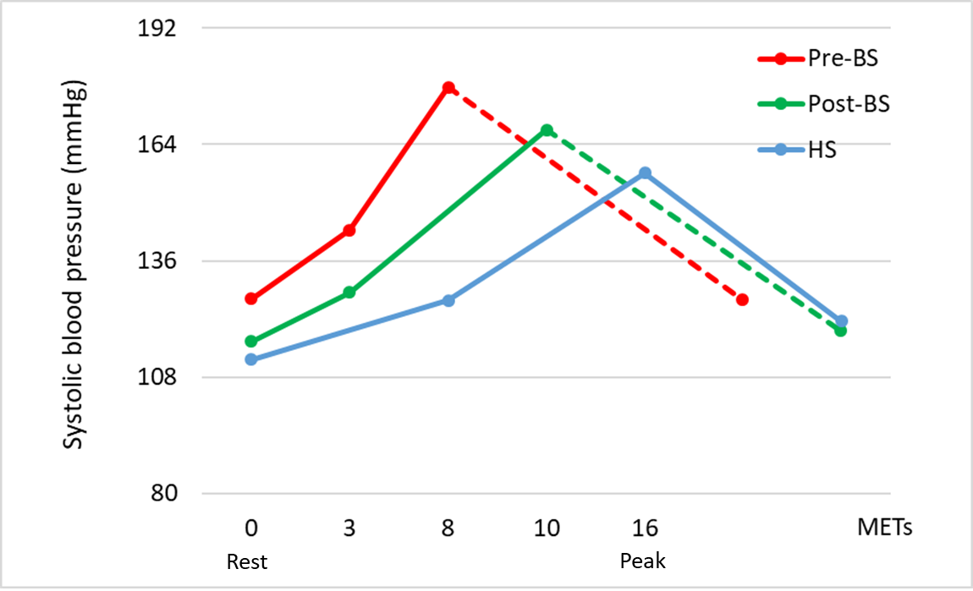
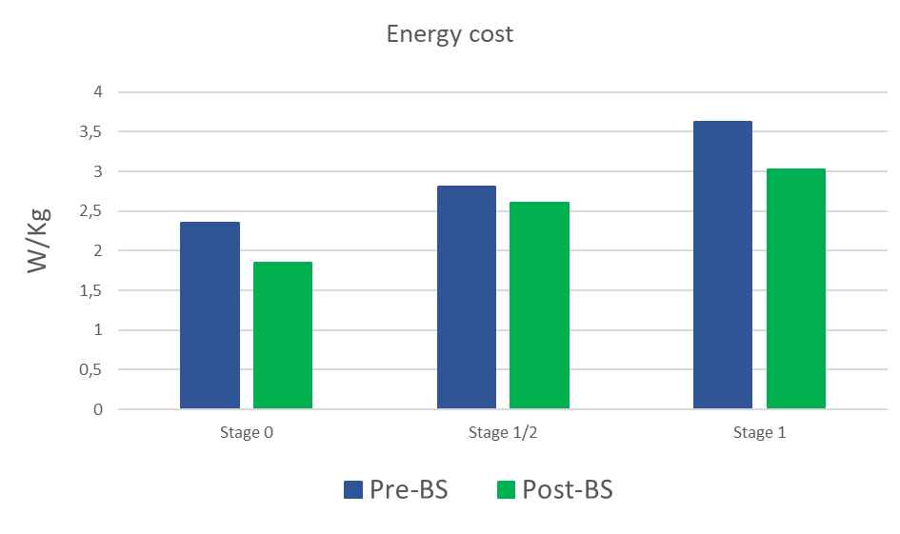
Functional benefits of weight loss
Ventilatory function
Blood pressure during exercise
Energetic cost of walk
Borasio, N; […] Battista et al. Obesity Surgery 2021
Battista, F, et al. Green visual poster @ECO2024
Vecchiato M, […] Battista F et al.; Biology 2023

Slide 4

FUNCTIONAL CAPACITY/BODY COMPOSITION
Sarcopenia
Muscle mass loss
Reduced absolute aerobic power
Low peripheral oxygen oxydation
UNTARGETED OUTCOMES
Functional capacity
Long-term outcome/weight regain
Quality of life
Mental wellbeing
Body composition

Slide 5
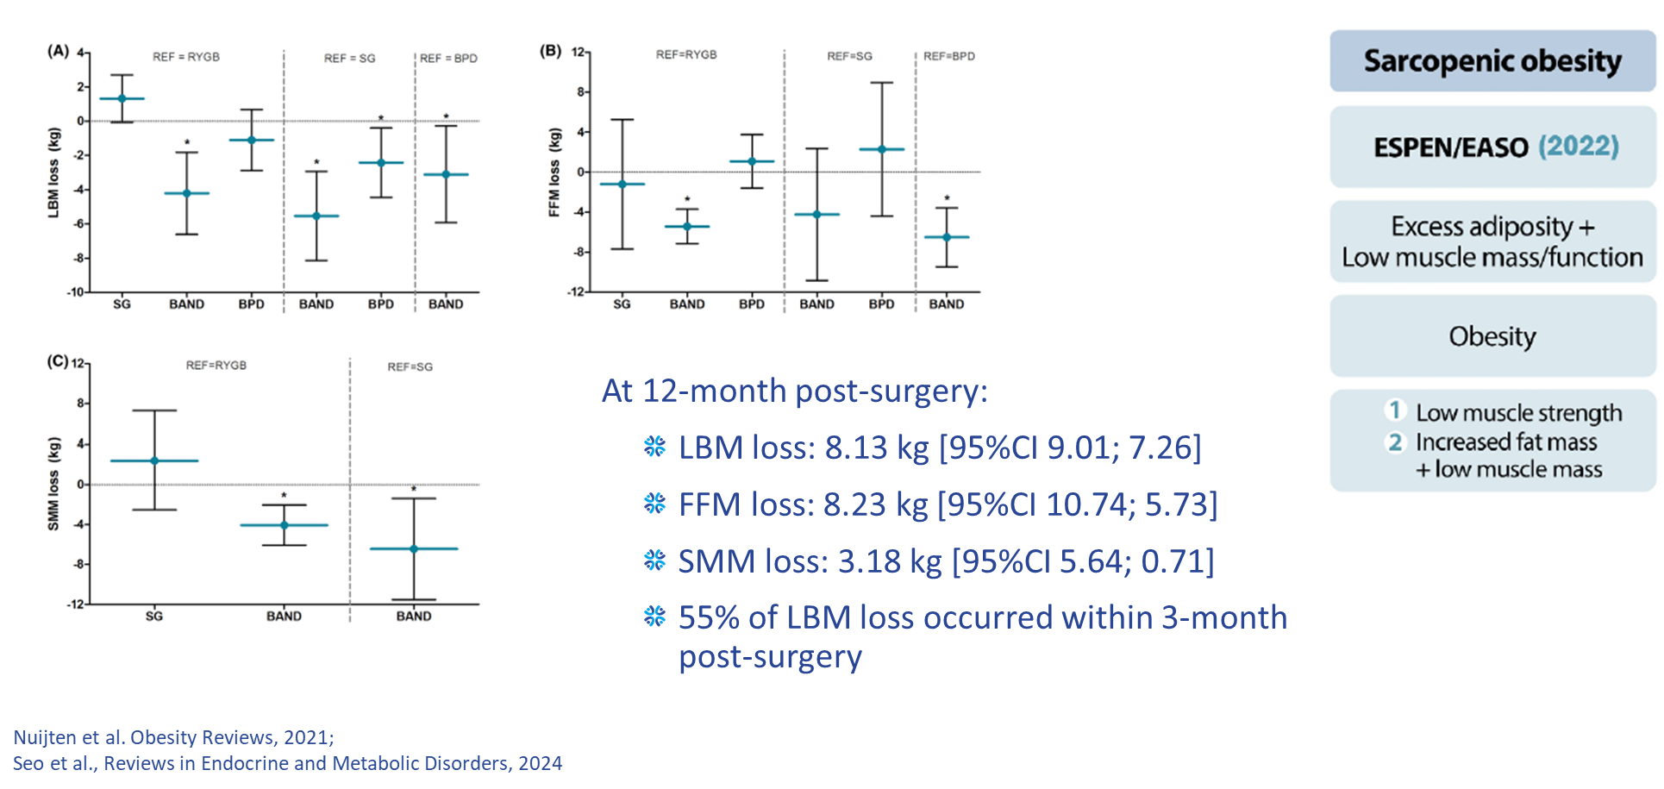
Sarcopenia after bariatric surgery

Slide 6
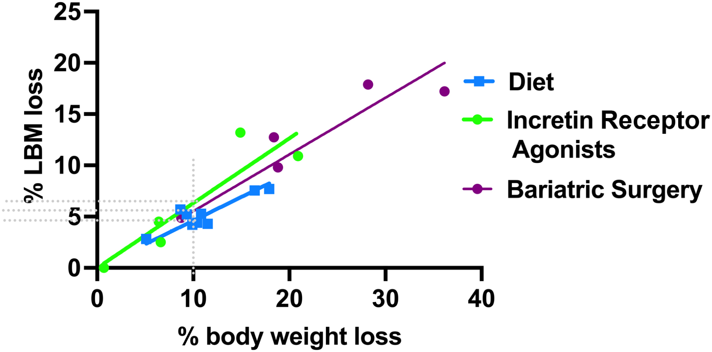
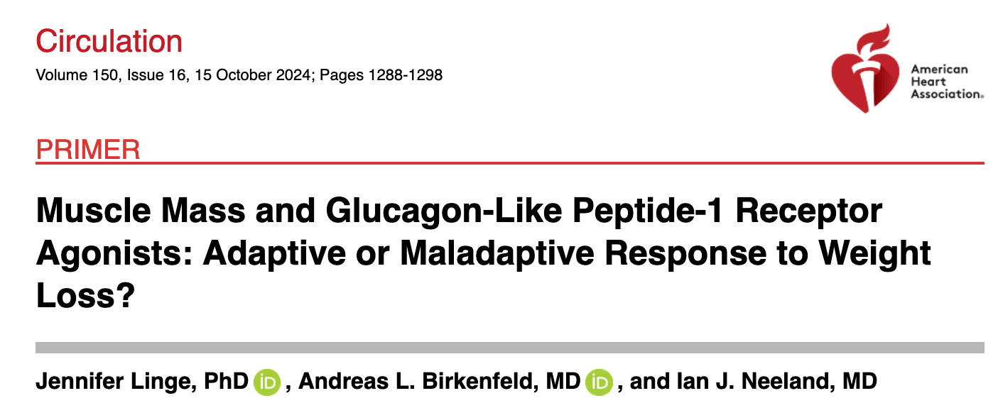
Sarcopenia after weight loss
% weight loss/% lean body mass loss resulting from diet; GLP-1 RA or GLP-1/GIP RA or bariatric surgery (various studies: Magkos et al, Villareal et al, Ravussin et al, Carey et al and Yoshino et al. ).

Slide 7
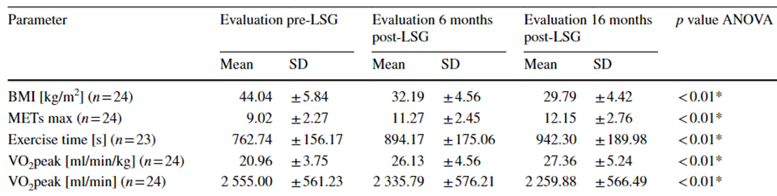
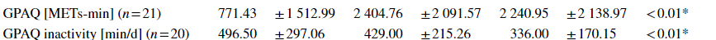
Functional effects of bariatric surgery
Weight related VO₂ (ml/min/Kg)
Absolute VO₂ (ml/min)
Level of physical activity
Neunhaeuserer D, […] Ermolao A; Internal and Emergency Medicine; 2020

Slide 8
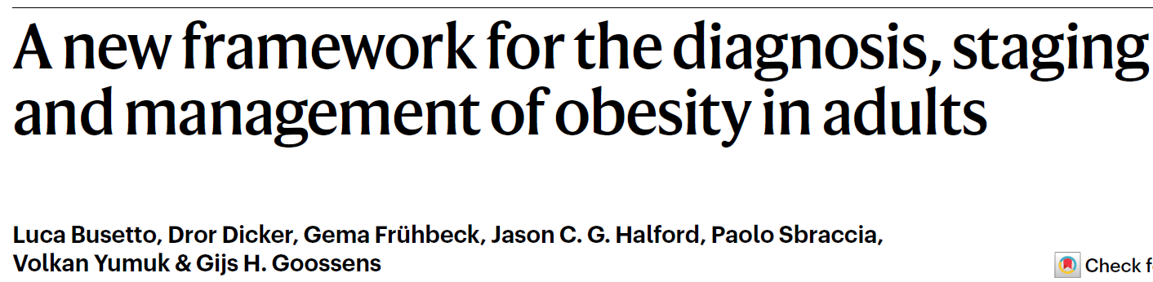
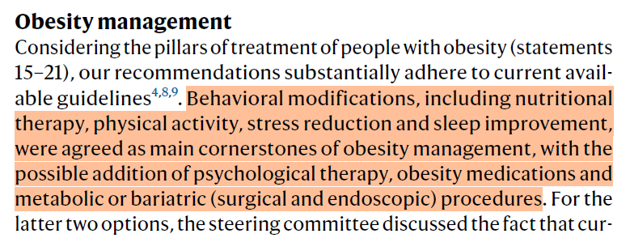
Theme | N. | Statement | Consensus (%)
Therapeutic targets | 22 | Consider that the management and treatment of obesity have wider objectives than weight loss alone and include the prevention, resolution or improvement of obesity-related complications, better quality of life and mental wellbeing, and improvement of physical/social functioning and fitness | 100%
 | 25 | Emphasize long-term, realistic, sustained weight loss to achieve a reduction in health risks and include promotion of weight maintenance and prevention of weight regain. Because obesity is a chronic disease, help persons with obesity understand that lifelong efforts are required to maintain a healthier body weight. | 96%

Slide 9


Slide 10
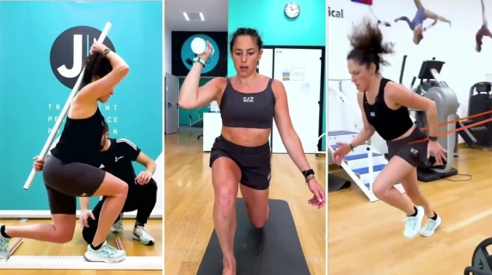
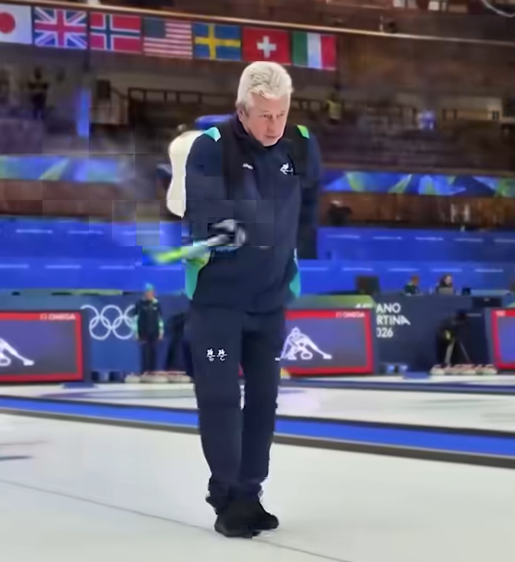
Web images
PHYSICAL ACTIVITY:
Any bodily movement produced by skeletal muscles that results in energy expenditure.
PHYSICAL EXERCISE: Subcategory of physical activity that is planned, structured, repeated with a given purpose.

Slide 11
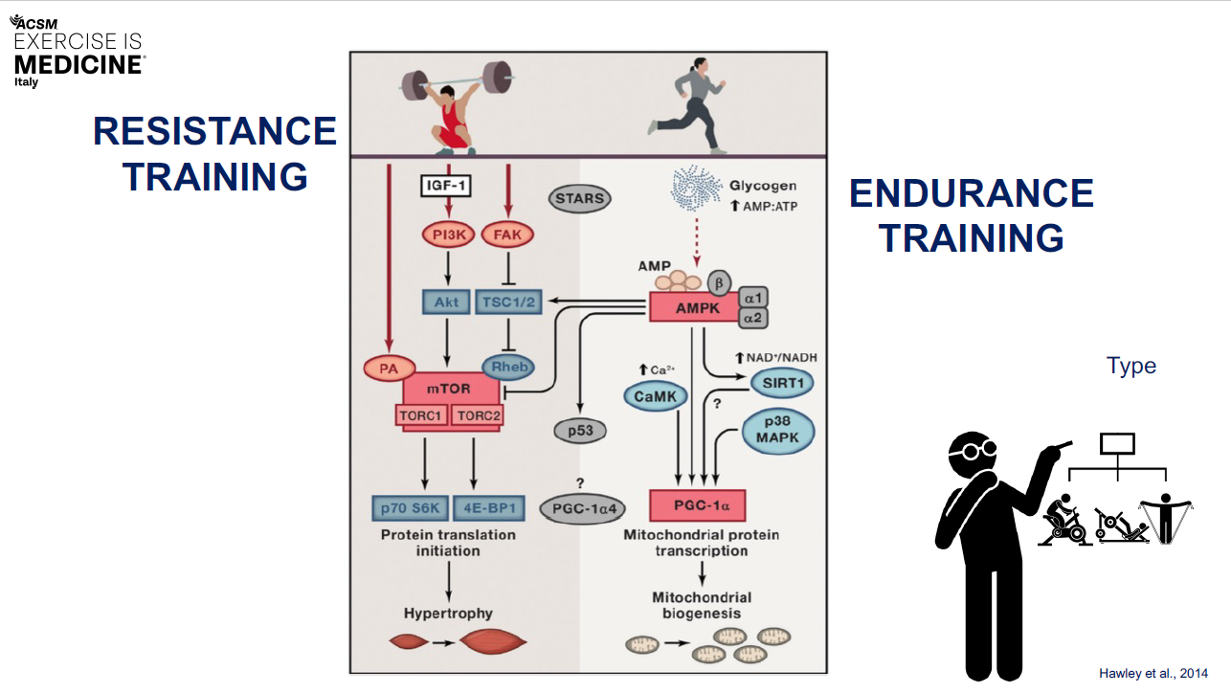

Slide 12
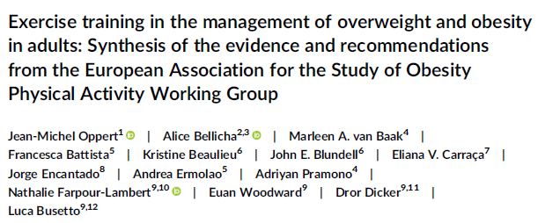
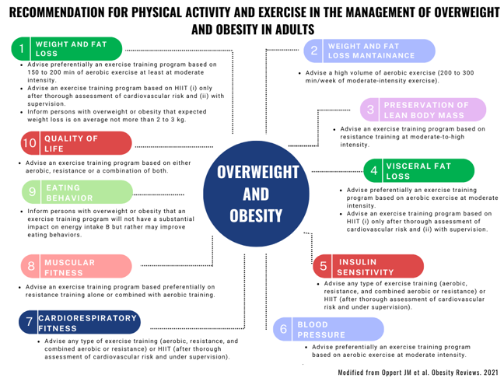

Slide 13
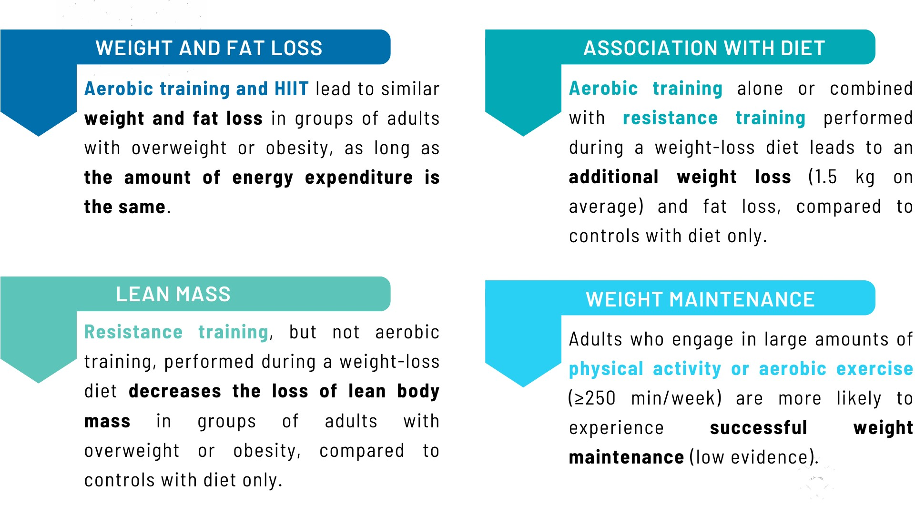
Effect on body composition and weight management
Bellicha et al., Obesity Reviews.

Slide 14
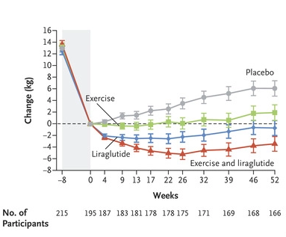
WEIGHT MAINTENANCE
Supervised group exercise sessions: 30 minutes of vigorous-intensity exercise 2 times/week
Moderate-to vigorous-intensity exercise individually 2 times/week
Exercise type at participant’s choice
Heart rate monitoring
VOLUME MATTERS!
Lundgren JR et al. CONSORT Trial, NEJM 2021; 384;18

Slide 15
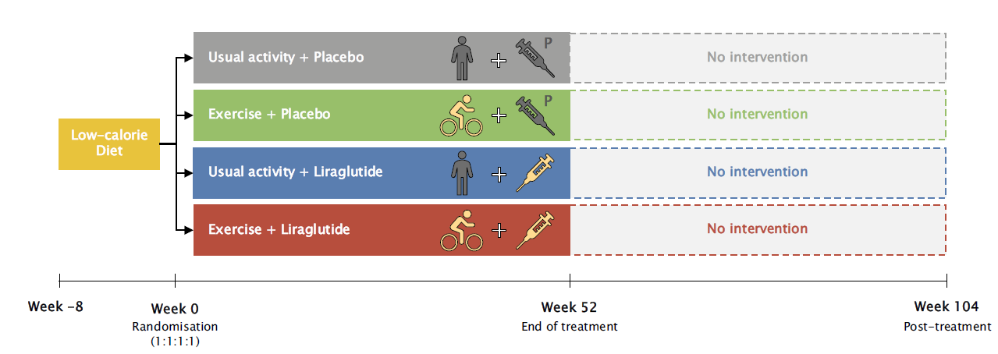
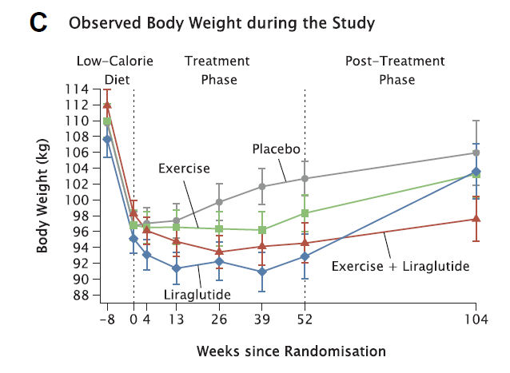
WEIGHT MAINTENANCE
VOLUME MATTERS!
Simon Birk Kjær Jensen, et al., The Lancet, 2024

Slide 16

EASO PAWG recommendation for weight loss
TIME
150-200’/w
INTENSITY
At least moderate
VOLUME
150’/w at moderate intensity = 750 Kcal/w
200’/w at moderate intensity = 1000 Kcal/w
150’/w at high or 300’ at moderate intensity = 1500 Kcal/w

Slide 17
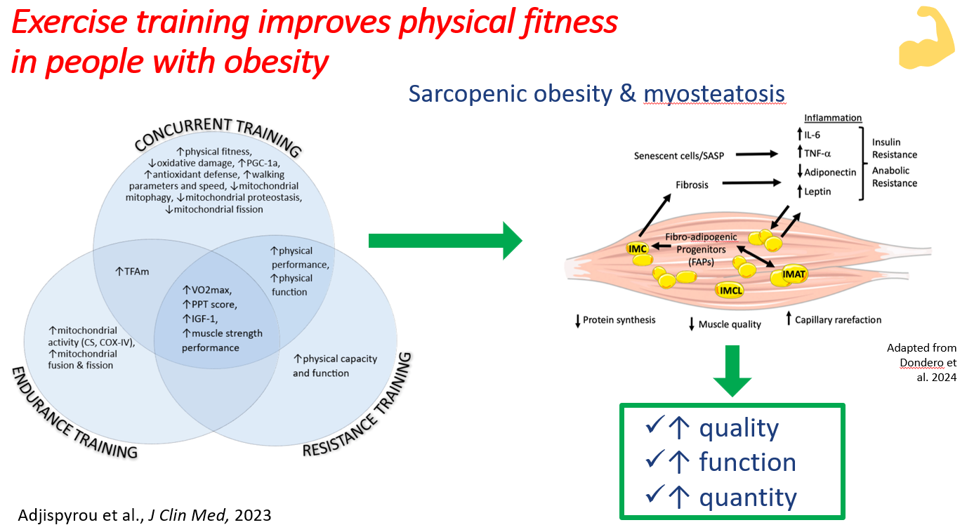

Slide 18
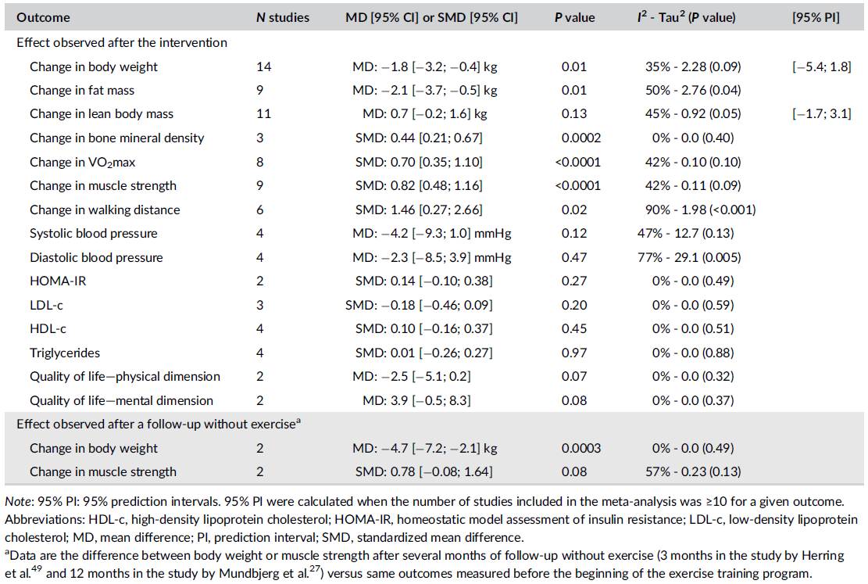
Effect of Exercise in obesity: bariatric surgery
POSTOPERATIVE INTERVENTION
Bellicha et al., Obesity Reviews. 2021.

Slide 19
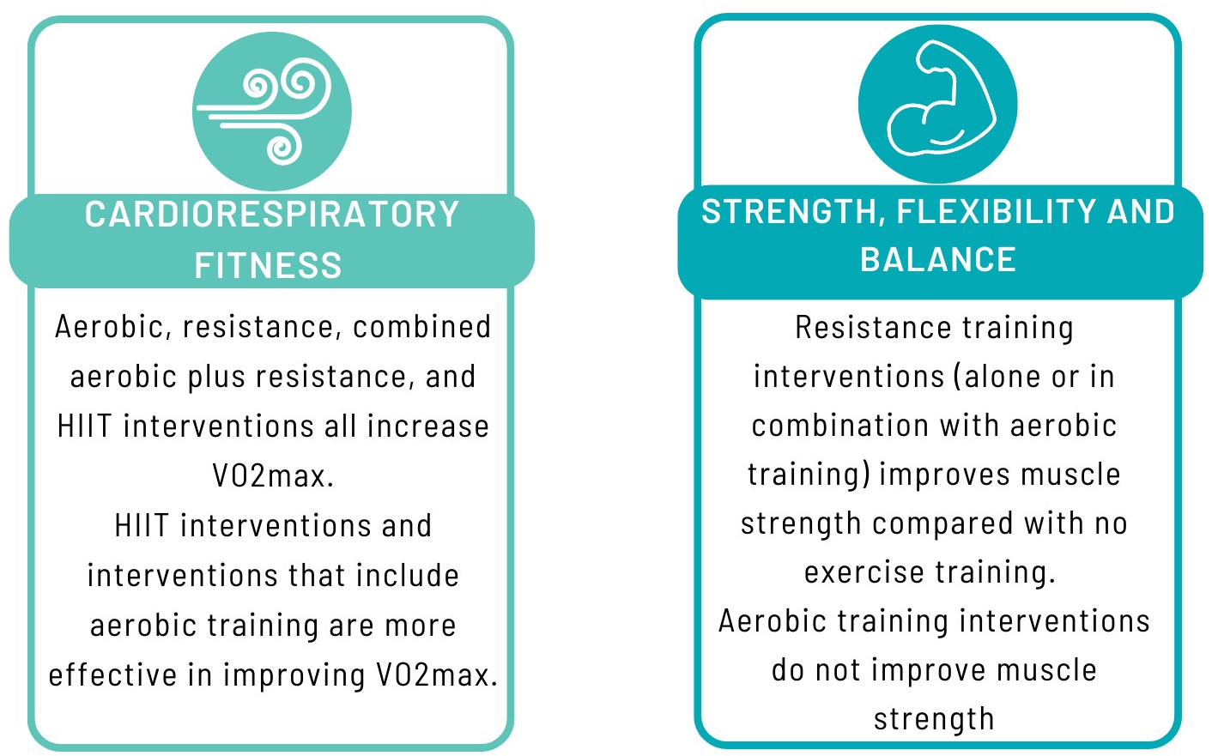
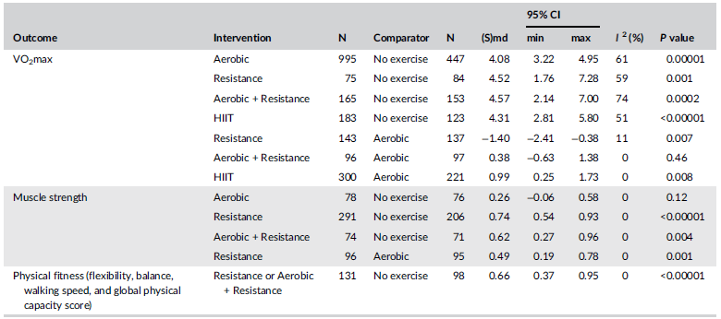
Effects of physical exercise on physical fitness
Van Baak et al., Obesity Reviews, 2021.

Slide 20
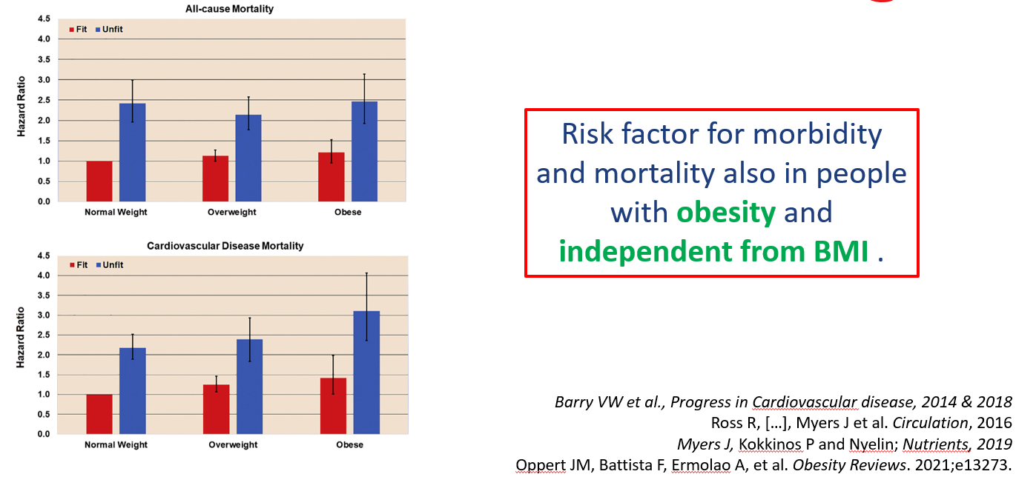
Prognostic value of cardiorespiratory fitness

Slide 21
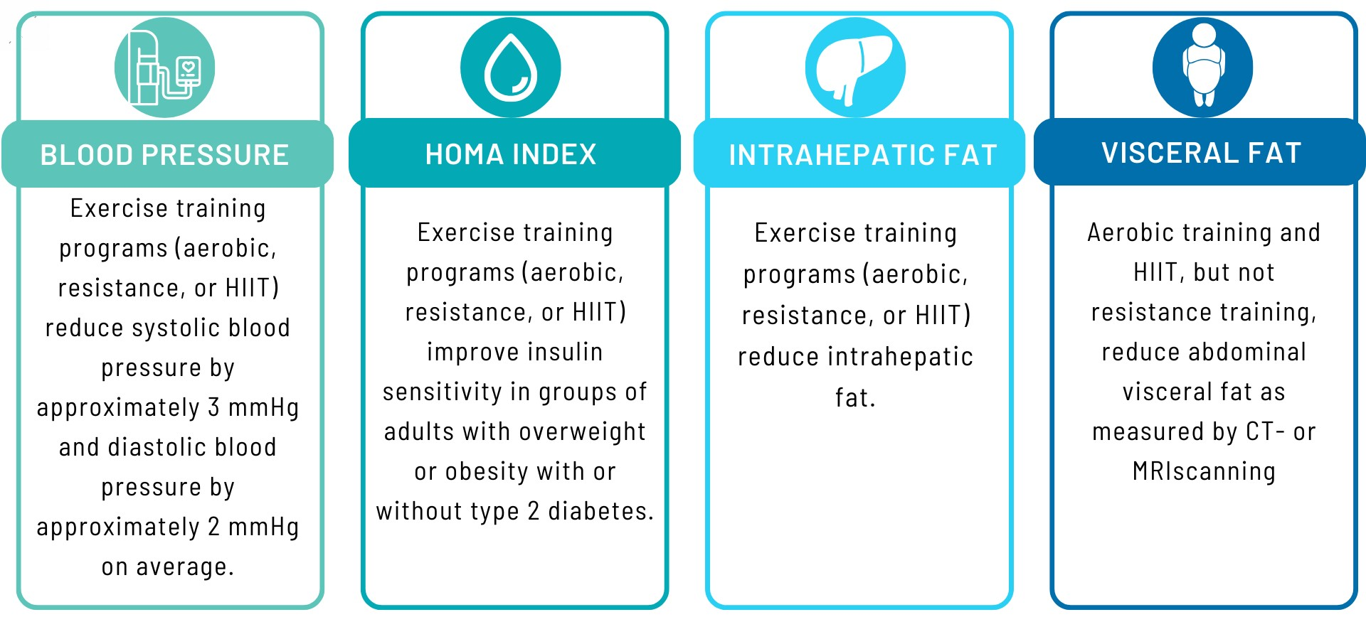
Effect on cardiometabolic health
Battista et al., Obesity Reviews; 2021.

Slide 22
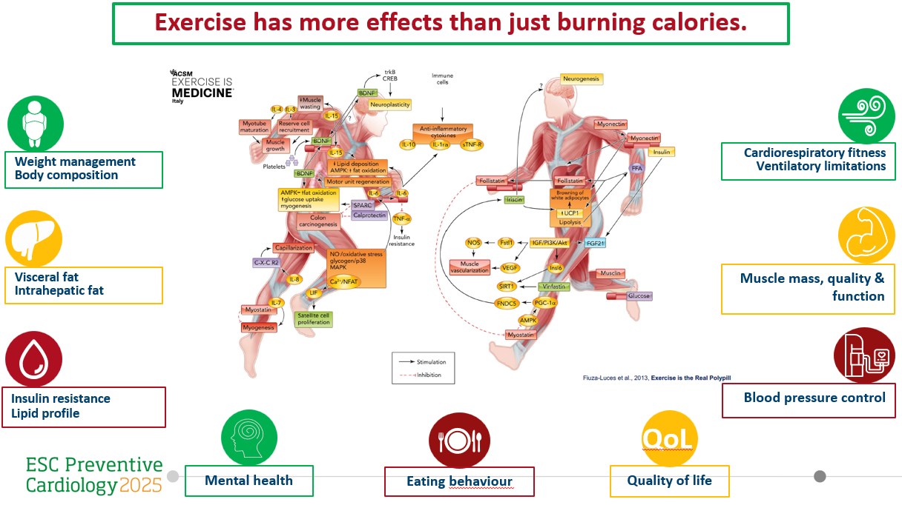


Slide 23
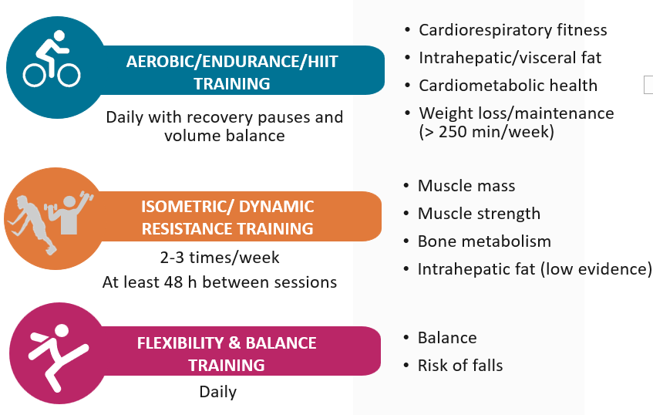

Recommendations for physical exercise in obesity
Cardiovascular screening before prescribing high intensity exercise
Check for hypertensive response during exercise
Adjust exercise intensity and recovery time also resistance training
Prevent joint overload
Avoid highly polluted environment.

Slide 24
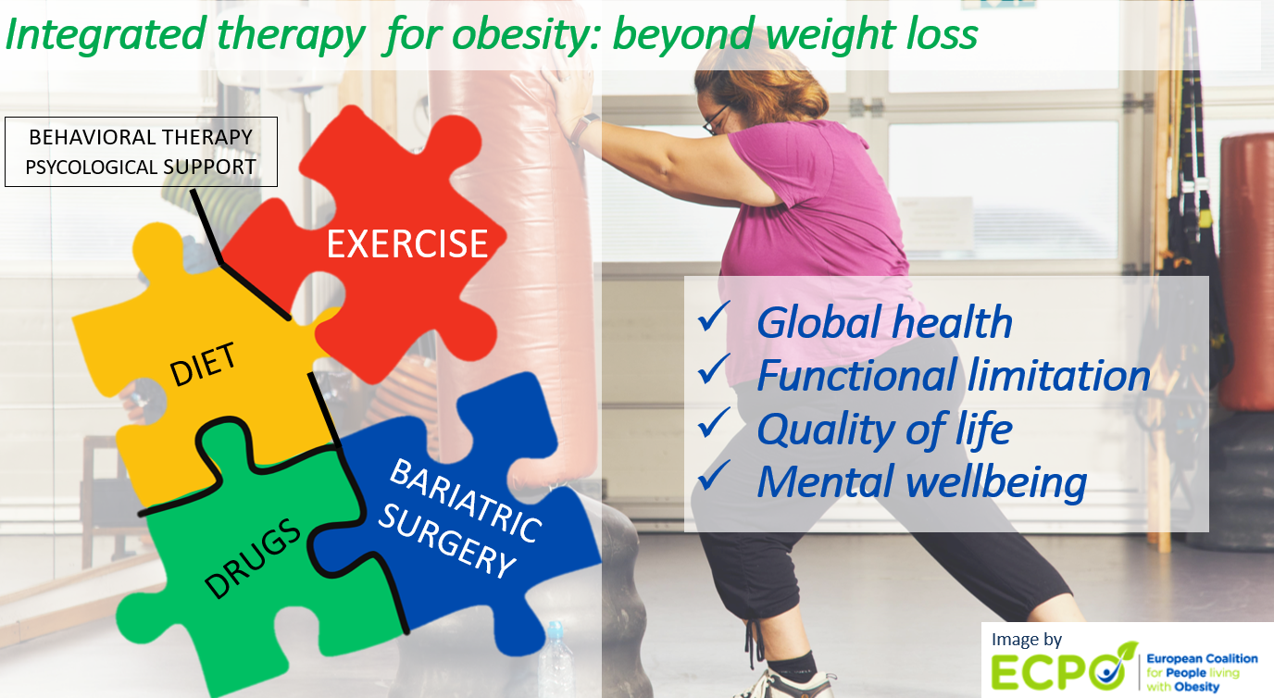

Slide 25
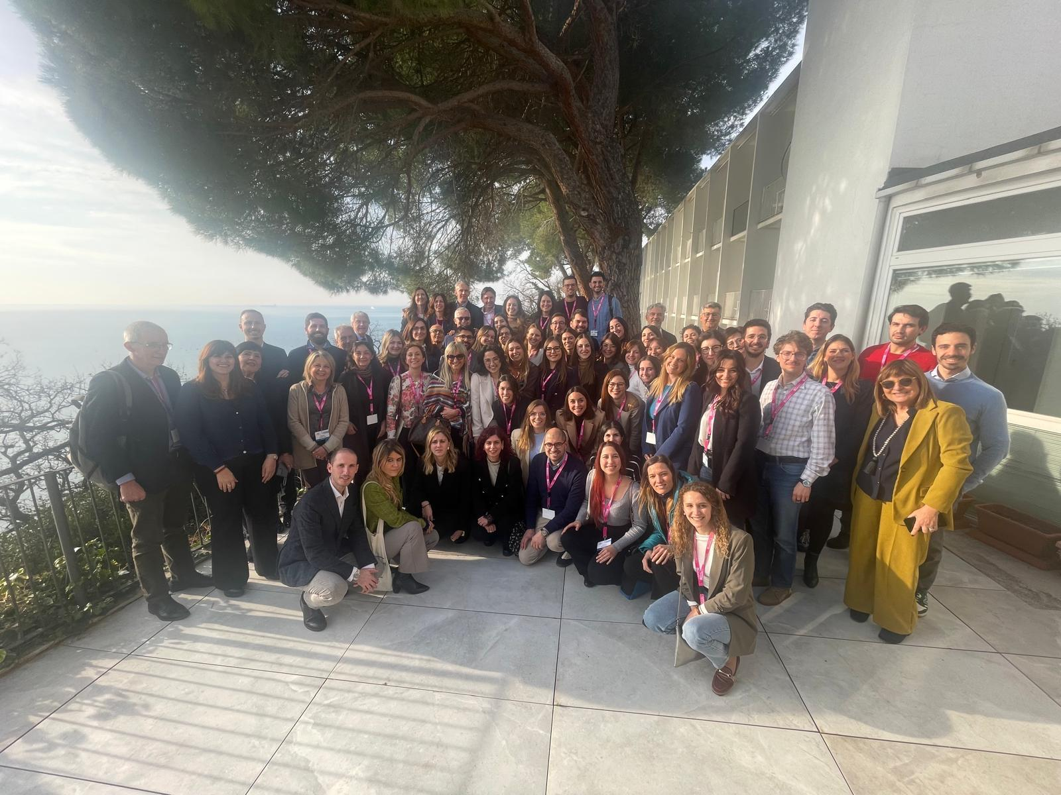
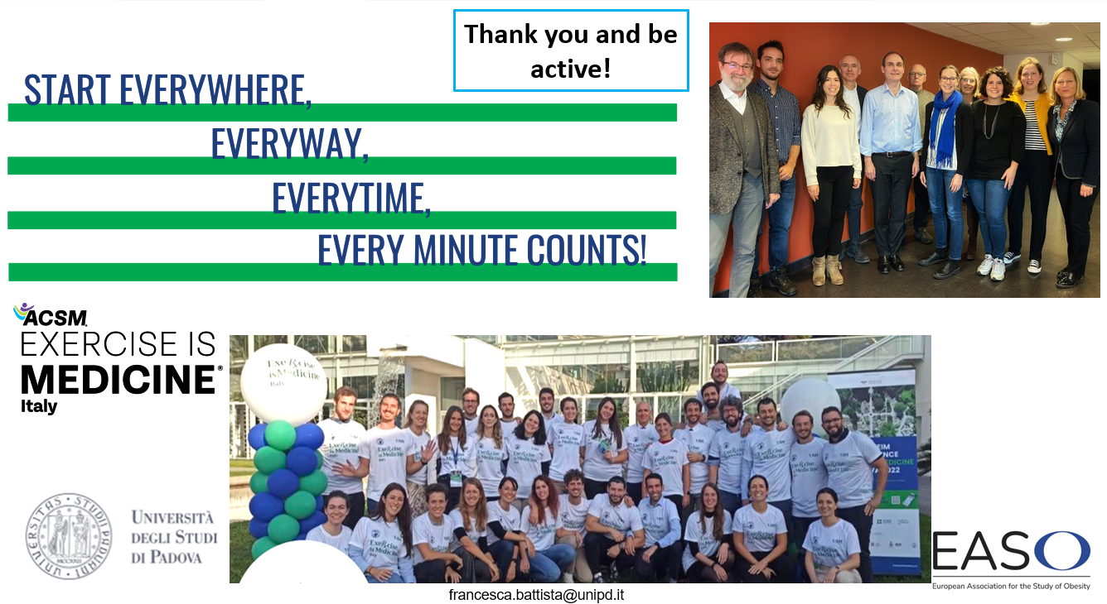
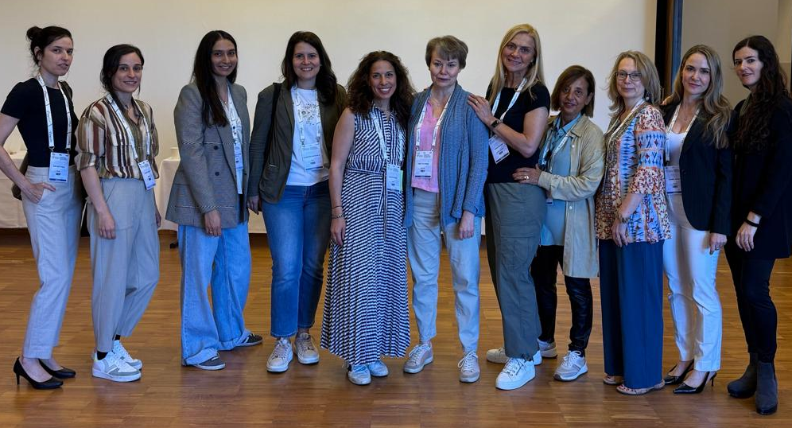
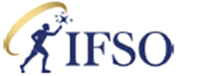
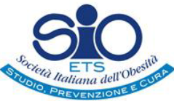


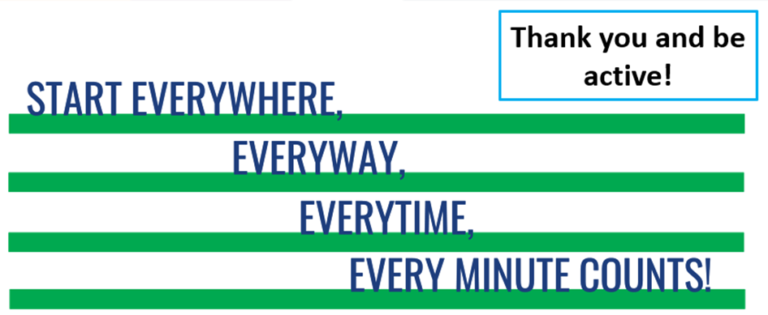
Integrated Health Commission
Physical Activity Working Group

